Slide 1
Selenium WebDriver Training
Test Automation :
Why, What & How?

Slide 2
The Golden Circle
What
What is test automation?
Anything that has been manually tested that are repetitive in nature and do not require different logic to perform
Why
Why test automation?
Save time, Save cost, improves quality
How is test automation performed?
How
There are plenty tools available in the market

Slide 3
Types of Automation
1
Browser, Desktop
Front End Automation
2
Services, Database
Backend Automation

Slide 4
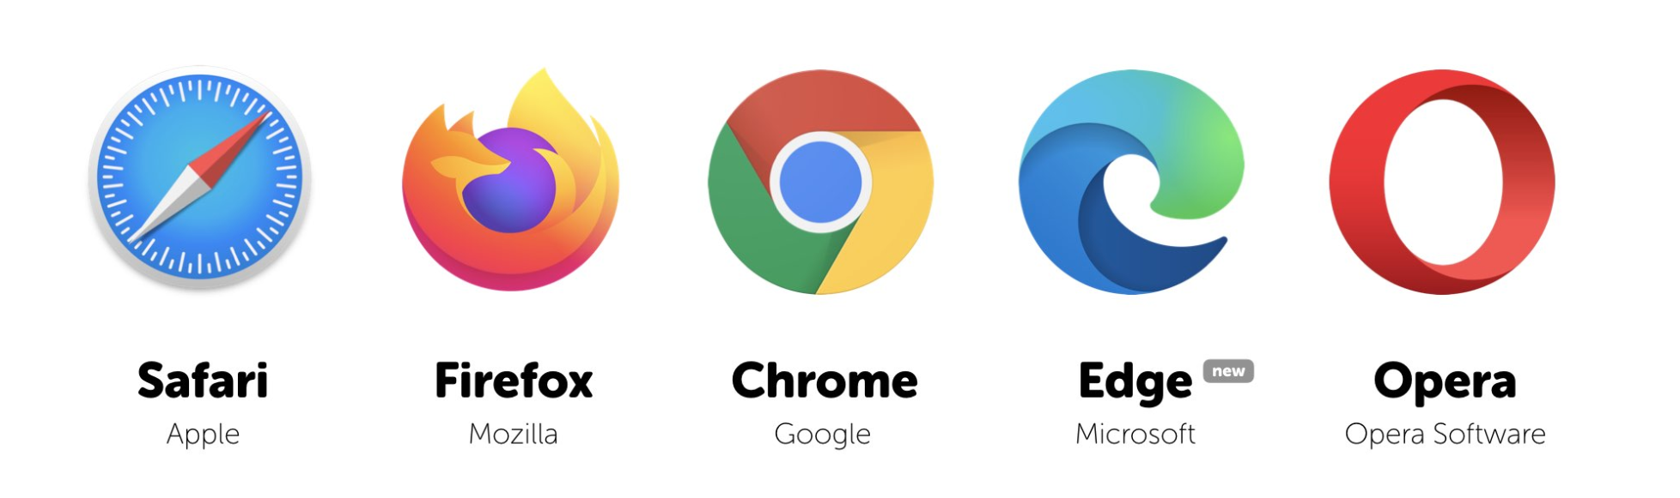
Browser Automation

Slide 5


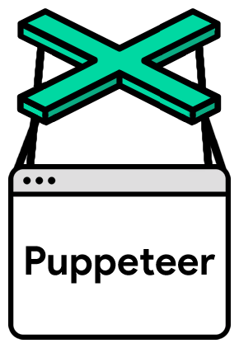
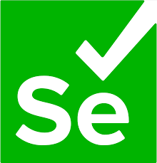
Opensource Browser Automation – Popular Tools
Selenium
Playwright
Cypress

Slide 6
Tool – Usage across world
Selenium
Playwright
Cypress
#1 – Max Downloads
Getting Popular
Decent Market Share
Developer Tool

Slide 7
Tool – Scripting Languages
Selenium
Playwright
Cypress
Core Java,
Python,
C#,
JavaScript,
Ruby,
Perl
Core Java,
Python,
C#,
JavaScript
JavaScript
JavaScript

Slide 8
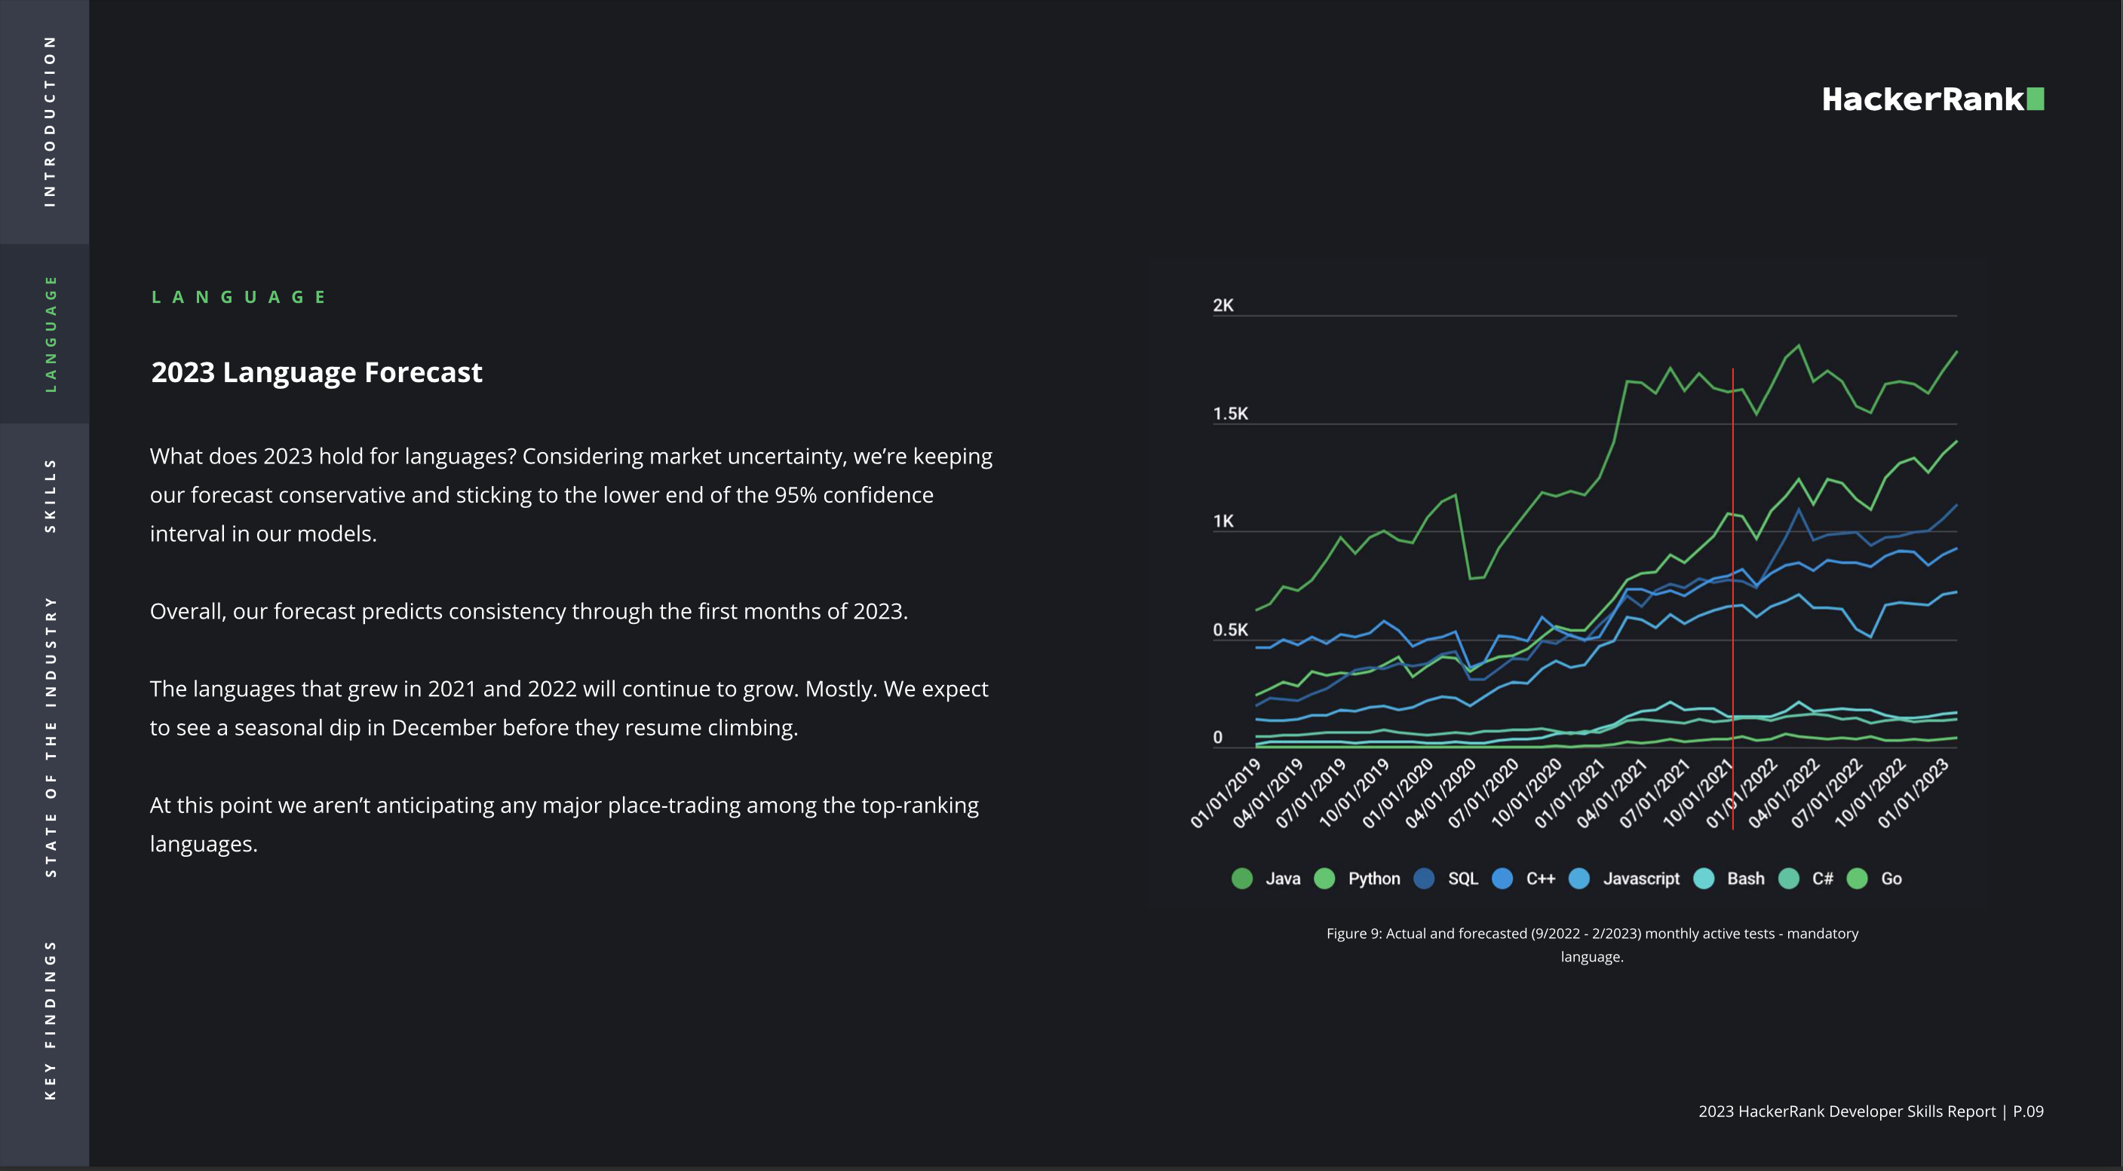
2023 – Language Forecast

Slide 9
Java is Popular Because
More than 70% of the automation openings are in Java with Selenium
Opportunities
KEYWORD
Easy to Integrate
Integration with API / Services or Containerization / Virtualization is easier
KEYWORD
Selenium WebDriver is built primarily on Core Java
Motherhood
KEYWORD
Step 04
TestNG, Apache POI, Extent Reports
Plenty of Libraries

Slide 10
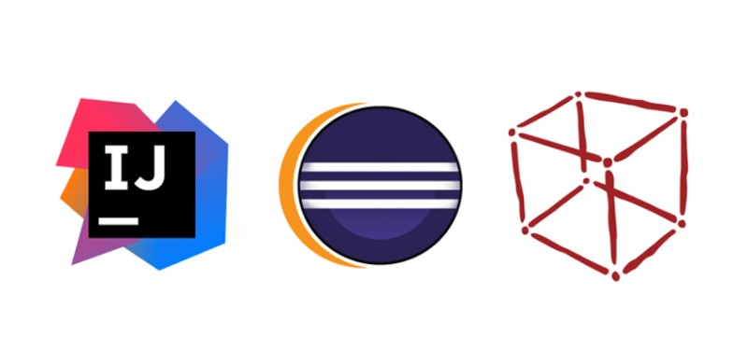
Java Editors

Slide 11
Check !
Java is ________________________________
Object oriented Programming language
Most popular language used by developers and automation engineers
Base language for Selenium WebDriver
All the above

Slide 12

How Java Works?
Java Code
(.java)
Save
Compiler
Run
JVM
.class
JRE (Java Runtime Engine)
JDK (Java Development Kit)

Slide 13
4 Things to Know before you start coding
Project
Package
Class
Variable & Method

Slide 14
A. Maven Project (starts with Upper case)
Easy to manage the software dependencies and versions
Easy to build as execution project library

Slide 15
B. Package (starts with lower case)
Like a folder in a drive (package in a project)
Helps to organize, provide security

Slide 16
C. Class Name (starts with Upper case)
Equivalent to a testcase (on closest comparison)
Perform set of actions (using methods)
It stores value (using variables)

Slide 17
D. Variable / Method Name (starts with lower case)
Both are members of the class
Variable – Store data
Method – Perform action

Slide 18
Note the naming conventions
Project (Upper case)
Package (lower case)
Class (Upper case)
Variable & Method (lower case)

Slide 19
Other 2 things before you start coding
main method
console output (print)

Slide 20
#1 Java main method ..
Main method is the entry point for executing Java Program
Without main method, the Java code will not execute by itself
public static void main(String args[]){
// write your code here
}

Slide 21
#2 sysout statement
Print the expected value in the console using sysout (shortcut) : ctrl + space
public static void main(String args[]){
System.out.println(”Here is my first code”);
}

Slide 22
Let us write a sample code ..
Java Code
(.java)
Save
Compiler
Run
JVM
.class
JRE (Java Runtime Engine)
JDK (Java Development Kit)

Slide 23
Summary
What, Why and How : UI Test Automation
Core Java Internals : JDK, JRE and JVM
Project, Package, Class, Method : Naming Convention

Slide 24
Classroom Exercise (Breakout)
Create a maven project using dependencies given (if not done before)
Create a new package by name : week1.day1 (lower case)
Create a new class by name : HelloSelenium (starts with Upper case)
Check main method and write a sysout statement
Save and run the code to confirm the value is printed
Go to target folder and confirm the class file is created

